Slide 1
FMHF Annual Retreat Serving God Through the Stages of our Lives Dr. Bill Morehouse – September 20, 2019
1

Slide 2
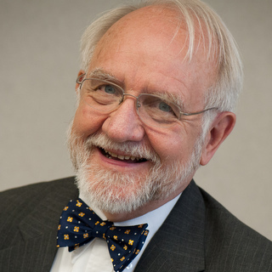
Hello!
I’m Bill Morehouse
My wonderful wife and life partner, Susan, and I are here because we love to share our faith with other committed believers like yourselves.
You can find us at online at www.hiskingdom.us and www.harpsongs.com.

Slide 3
Schedule Overview
Tonight – Introduction
Where are we?
Growing through life’s seasons
Tomorrow am – 6 Group Topics
Medical practice as a mission
Prayer with patients
Serving the poor
Community outreach
Mentoring students
Preparing for retirement
Tomorrow evening – Recap

Slide 4
1 Tonight’s topics
Where are we?
Stages of Life
My testimony
Family and Career
Graduating into Retirement

Slide 5
Where are we?
A
We’ve been called together as born again believers from evangelical backgrounds to grow in our care for our Lord, each other, and the afflicted.
Many of us are Free Methodists based in a reformation movement who are committed to personal sanctification, holiness, and the witness of godly living.

Slide 6
Your decrees are very trustworthy; holiness befits your house, O Lord, forevermore.
We have all become like one who is unclean, and all our righteous deeds are like a polluted garment. We all fade like a leaf, and our iniquities, like the wind, take us away.
Therefore lift your drooping hands and strengthen your weak knees, and make straight paths for your feet, so that what is lame may not be put out of joint but rather be healed. Strive for peace with everyone, and for the holiness without which no one will see the Lord.
Psalm 93:5
Isaiah 64:6
Hebrews 12:12-14

Slide 7
Stages of Life
B

Slide 8
For everything there is a season, and a time for every matter under heaven: a time to be born, and a time to die; a time to plant, and a time to pluck up what is planted; time to kill, and a time to heal; a time to break down, and a time to build up; a time to weep, and a time to laugh; a time to mourn, and a time to dance; a time to cast away stones, and a time to gather stones together; a time to embrace, and a time to refrain from embracing; a time to seek, and a time to lose; a time to keep, and a time to cast away; a time to tear, and a time to sew; a time to keep silence, and a time to speak; a time to love, and a time to hate; a time for war, and a time for peace.
Ecclesiastes 3:1-8

Slide 9
Four Stages of Life
1
First
The period of childhood and young adulthood dedicated to nurture in family, learning, and maturing into adulthood
2
Second
Creating a family, building a career, and accumulating wealth. Often attached to earthly rewards like money, power, prestige
3
Third
Progressively transitioning responsibilities and becoming more and more devoted to mentorship, wise service, and spirituality
4
Last
Ideally becoming dedicated to sharing the fruits of enlightenment and preparing for the life to come
0 25 50 75 100
Some careers like ministry and primary care may merge 3-4 closer into 2

Slide 10
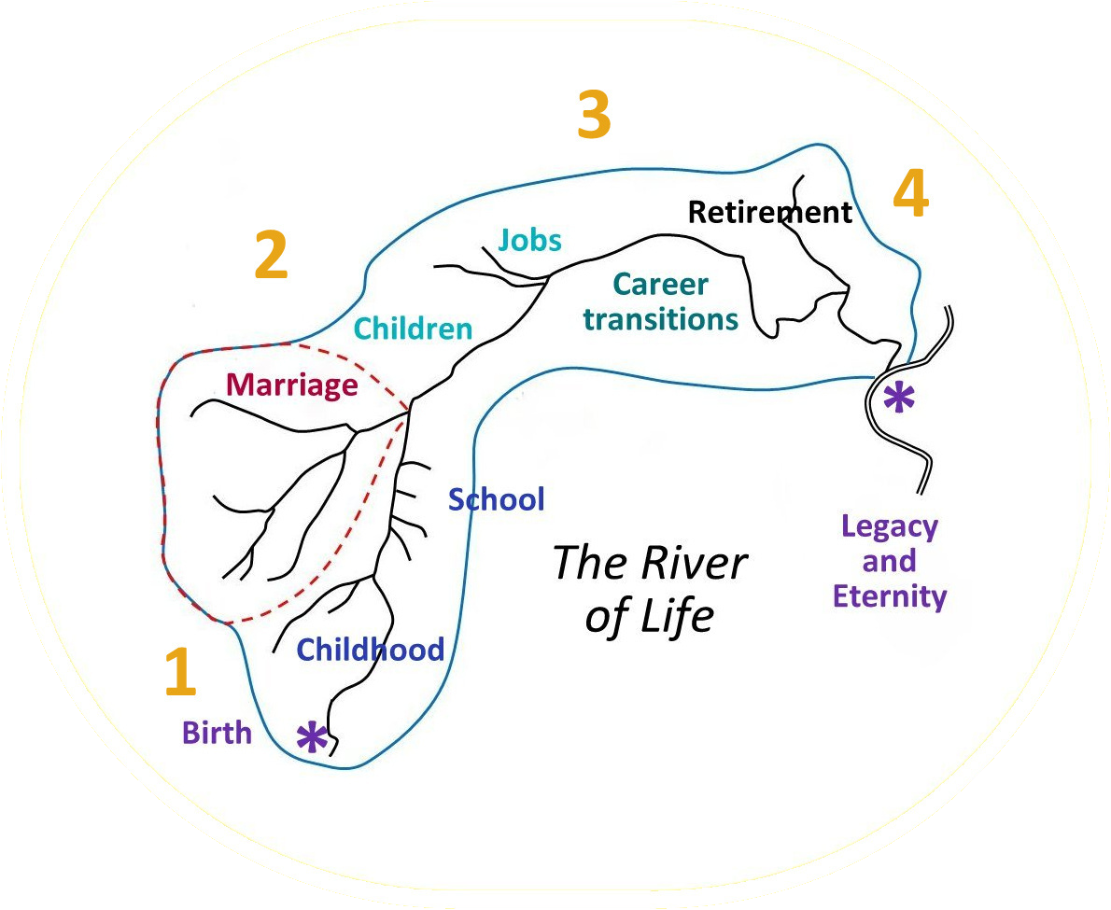
The River of Life With grateful credit to Dr. Daniel Fountain

Slide 11
Life Tasks in Each Stage
1
First
How to receive nurture and love others, how to appreciate studying and learning, and finding out who you are on way to adulthood
2
Second
Overcoming childhood handicaps, taking responsibility for your life and others, being productive in a career
3
Third
Getting a broader perspective and preparing for the future by helping others pick up where you will be leaving off
4
Last
Applying your life experience to benefit others with spiritual and practical insights, wisdom, and support
0 25 50 75 100
Note roles of older and younger described in Titus 1 and 2

Slide 12
River of Life Inventory
Draw your life as a river
Start with birth
Go through childhood, adolescence, and adulthood to the present
Recall and draw as tributaries the major influences on your life and the major events from childhood until now
Evaluate them as positive or negative

Slide 13
Positive Influences
Heritage and parents
Childhood influences
Good lessons learned
Positive events and accomplishments
Blessings from God – tender mercies
Give thanks to God for all he has done

Slide 14
Obstacles to Maturity
Heritage and childhood problems
Bad choices and traumatic events
Events that happened to us, or sins committed that still cause guilt
Are negative influences of any of these still having an influence?
Talking or writing about them and yielding them to Christ resolves the inner pain, confusion, and lack of peace

Slide 15
Objections
Some people say we shouldn’t try to deal with our past.
The Apostle Paul said we are to forget what is behind and strive to reach what is ahead. Philippians 3:13
But we can’t let go of the past until we’ve gotten a clear grasp and handled it faithfully.
Paul dealt with his past. Phil. 3:1-11

Slide 16
Remember also your Creator in the days of your youth, before the evil days come and the years draw near of which you will say, “I have no pleasure in them”; before the sun and the light and the moon and the stars are darkened and the clouds return after the rain, in the day when the keepers of the house tremble, and the strong men are bent… the almond tree blossoms, the grasshopper drags itself along, and desire fails, because man is going to his eternal home, and the mourners go about the streets – before the silver cord is snapped, or the golden bowl is broken, or the pitcher is shattered at the fountain, or the wheel broken at the cistern, and the dust returns to the earth as it was, and the spirit returns to God who gave it.
Ecclesiastes 12:1-7

Slide 17
My testimony
C
Called a “conversion narrative” by Puritans “to draw a distinction between easy self-righteousness and the new birth of saving grace.”
The following descriptions are from Puritan pastors Thomas Hooker (1586-1647) and Thomas Allen (1608-1673).

Slide 18
Hooker’s Six Essentials
1. Contrition
Man should look into the Law of God* and make an examination of his life and state according to the Law.
4. Implantation
True humiliation of heart, grief and fear because of sin. Confession.
2. Humiliation
Conviction of conscience by which seeker realizes that he is under sin.
5. Exaltation
First entrance into the state of saving grace.
3. Vocation
Despair of salvation, in respect to strength of self and other creatures.
6. Possession
Awareness of presence of faith.
* “Law” of God = Biblical teaching

Slide 19
Allen’s Synopsis
Agitations of the soul lead to the sinner's deep sense of concern and humiliation at his condition.
The stricken sinner attempts to redress the wrongs he has done through “legal obedience” by turning to good works as a remedy, but this effort fails and he is brought to deeper despair.
The sinner experiences worsening despair and misery. He sees all his efforts as vain and inconsequential before a perfect God.
At the most abject moment of despair, the soul bottoms out, begins to understand God's grace, and is elevated to an appreciation of it.
Gratitude causes the sinner to live a new life of obedience and thanksgiving, although human nature and pride may cause him to backslide and to rely on his own will and works once again.
Because of this temptation, individuals must continually monitor their spiritual state and repeat the process of conversion if necessary.
Note similarity to
Revivals of faith over the centuries as well as 12-Step and Celebrate Recovery

Slide 20
Revival Cycles
Revivals of faith, from Old Testament times to the present, historically come in cycles.
First disunity and social and moral decay set in leading to a growing sense of emptiness, hunger and yearning for better times.
This is followed by a renewed sensitivity to spiritual matters and rediscovery of the power of the Word of God, leading into a rising time of inspired revitalization of human ideals and values.
The result is a groundswell of conviction and repentance that produces a host of positive, godly moral and social endeavors, after which the community drifts into an ebbing time, becomes less cohesive, and settles back into more conventional social patterns.
Finally disunity and social and moral decay set in again and reach a point where the cycle starts over, each time building on advances that have been made in the past.

Slide 21
Celebrate Recovery
Realize I’m not God; I admit that I am powerless to control my tendency to do the wrong thing and that my life is unmanageable. (Step 1)
Earnestly believe that God exists, that I matter to Him and that He has the power to help me recover. (Step 2)
Consciously choose to commit all my life and will to Christ’s care and control. (Step 3)
Openly examine and confess my faults to myself, to God, and to someone I trust. (Steps 4 and 5) - also known as “a fearless moral inventory”
Voluntarily submit to any and all changes God wants to make in my life and humbly ask Him to remove my character defects. (Steps 6 and 7)
Evaluate all my relationships. Offer forgiveness to those who have hurt me and make amends for harm I’ve done to others when possible, except when to do so would harm them or others. (Steps 8 and 9)
Reserve a daily time with God for self-examination, Bible reading, and prayer in order to know God and His will for my life and to gain the power to follow His will. (Steps 10 and 11)
Yield myself to God to be used to bring this Good News to others, both by my example and my words. (Step 12)

Slide 22
My story
Brought up in a middle class church-going Protestant/Episcopal family
A “good kid,” student, Boy Scout, youth group…
Drifted into broad-based religious humanism in college and med school
Counter-culture in residency and strayed far into sinful philosophies, behavior, and stress
Cried out to God; called to a prayer group; met the Lord and committed my life to Christ
Raised up in evangelical, Spirit-filled churches
Met Susan in Bible study - married in 6 months.

Slide 23
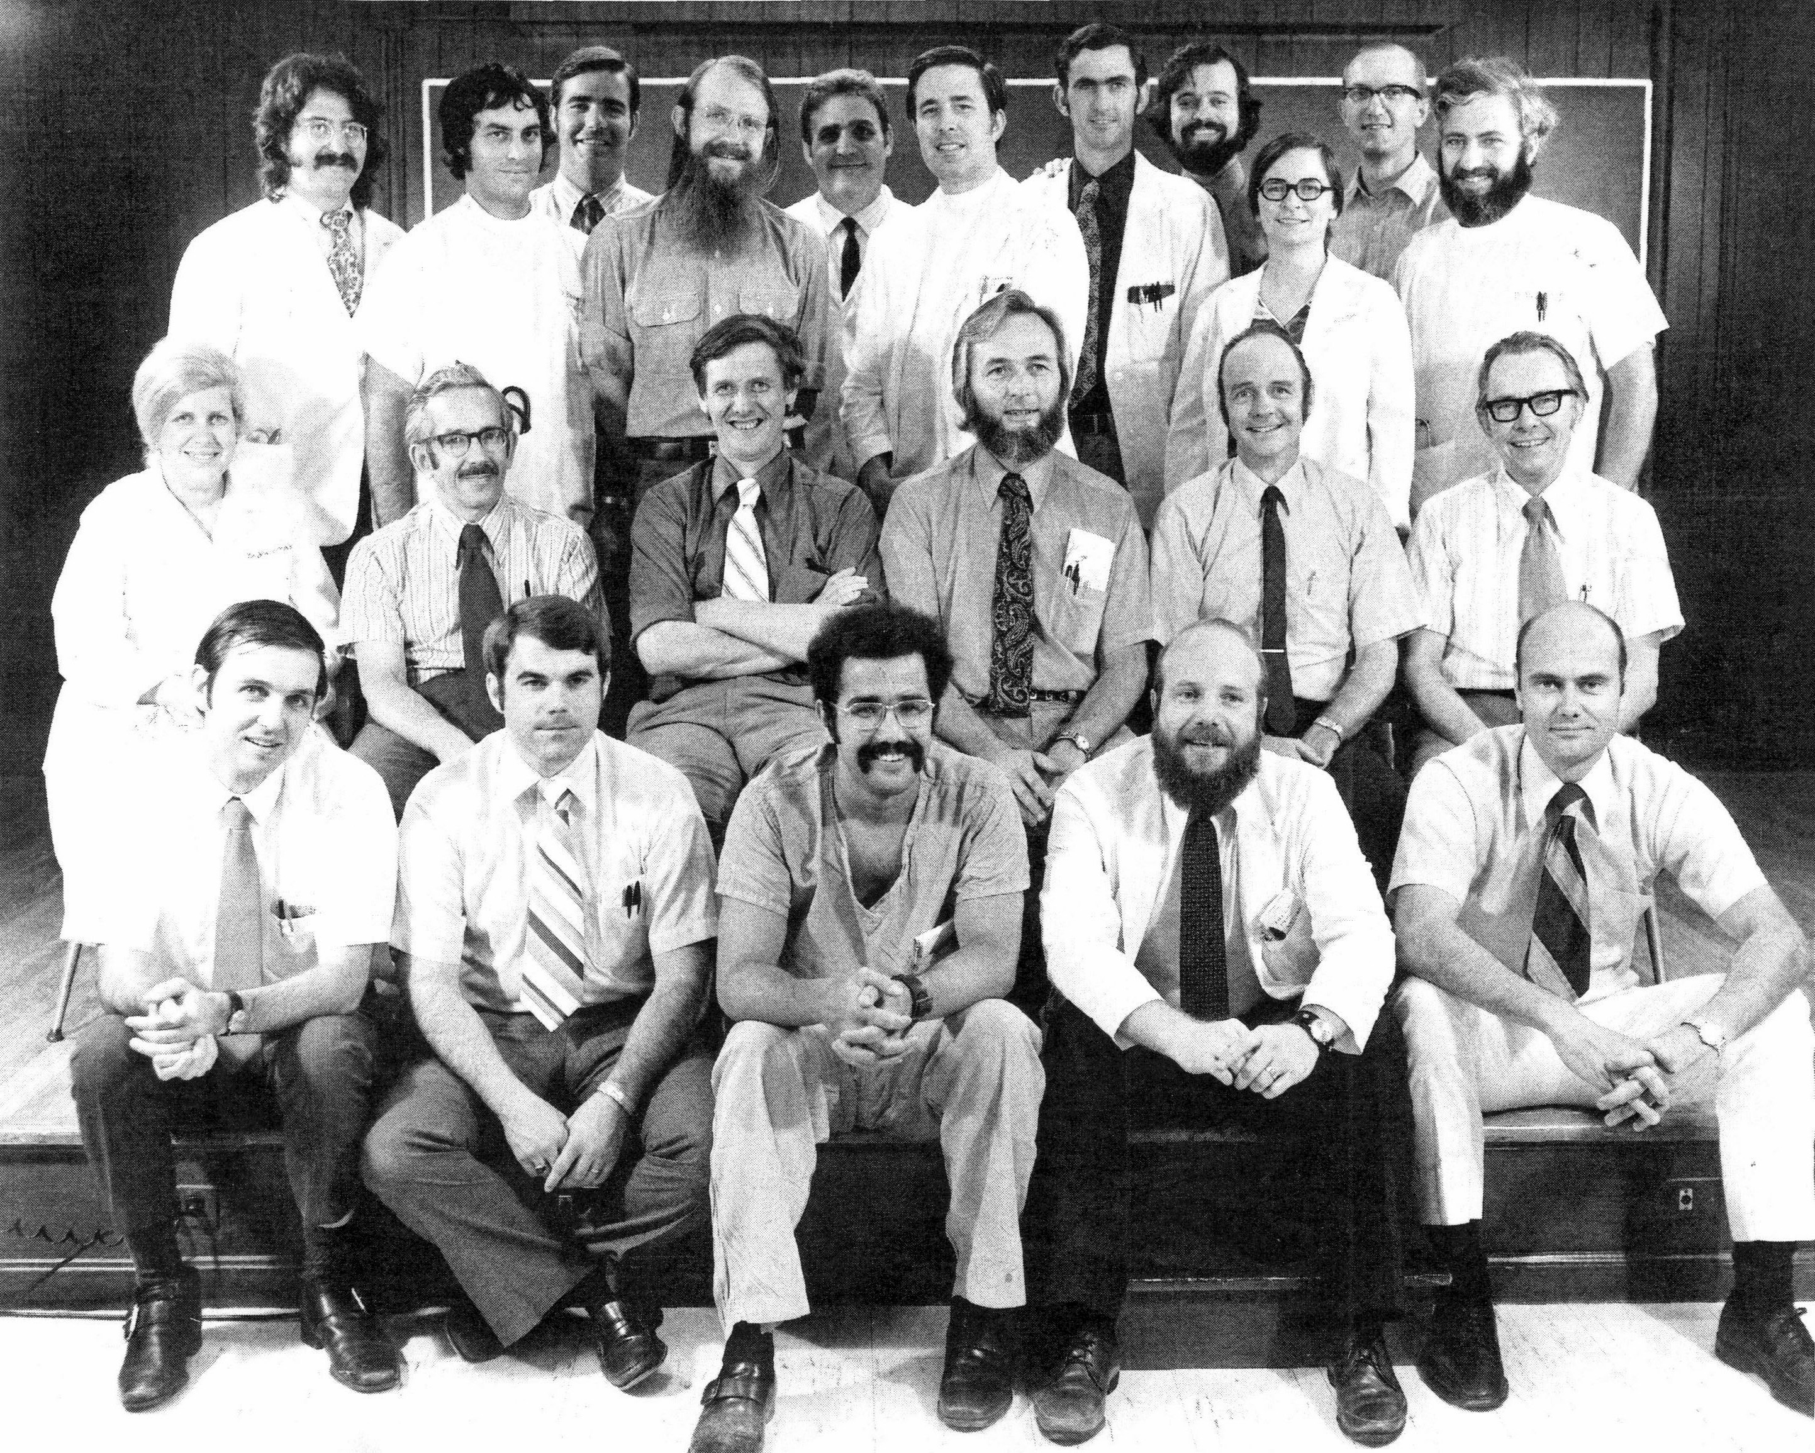
Family
Medicine
Program
1972

Slide 24
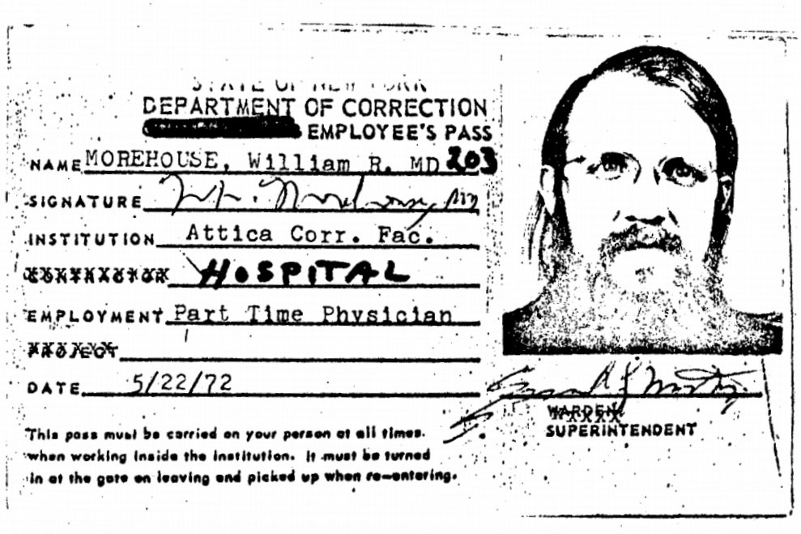
Attica
1972

Slide 25
Family and Career
D
Training, early practice, reexamination after conversion, sense of calling, marriage, family and church life, dedicated career serving the disadvantaged in Jesus’ Name

Slide 26
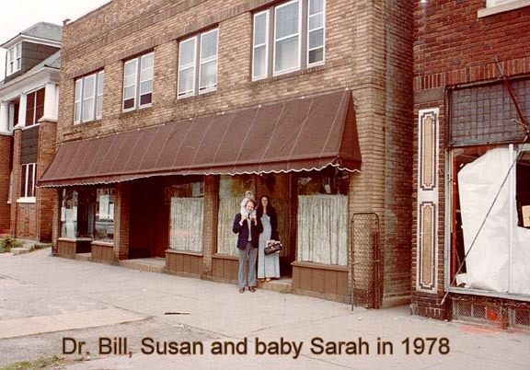
Starting at
His Branches

Slide 27
Family and Career
Training and early practice
Reexamination after conversion
Sense of calling in marriage
Family and church life
Dedicated to home missions serving the disadvantaged in Jesus’ Name with some abroad
Struggles along the way

Slide 28
The righteous flourish like the palm tree and grow like a cedar in Lebanon. They are planted in the house of the LORD; they flourish in the courts of our God. They still bear fruit in old age; they are ever full of sap and green, to declare that the LORD is upright; He is my Rock, and there is no unrighteousness in Him.
Psalm 92:12-15

Slide 29
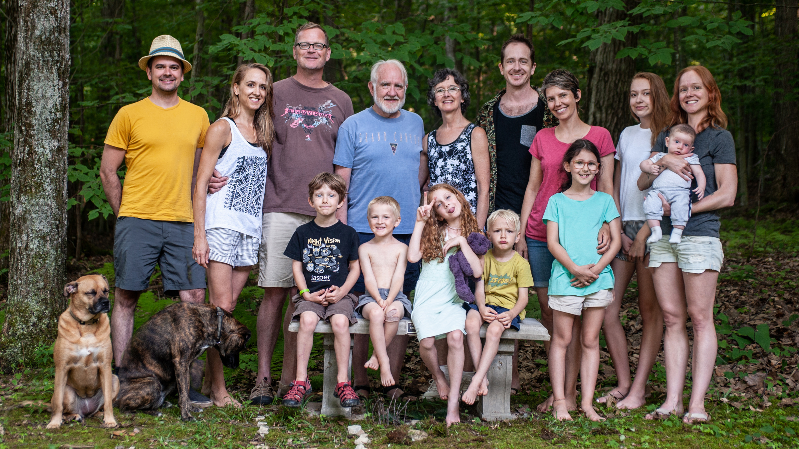
Want big impact? Use big image.

Slide 30
Graduating into Retirement
E
Preparation, mentorship, progressively passing the baton,
leaving a legacy, investing in extended family, focusing
on building in His broader Kingdom

Slide 31
Graduating into Retirement
Five F’s:
Faith, Family, Finances, Fitness, and Fruitfulness
Preparation and mentorship
Progressively passing the baton
Investing in extended family
Focusing on building in His Kingdom
Leaving a legacy

Slide 32
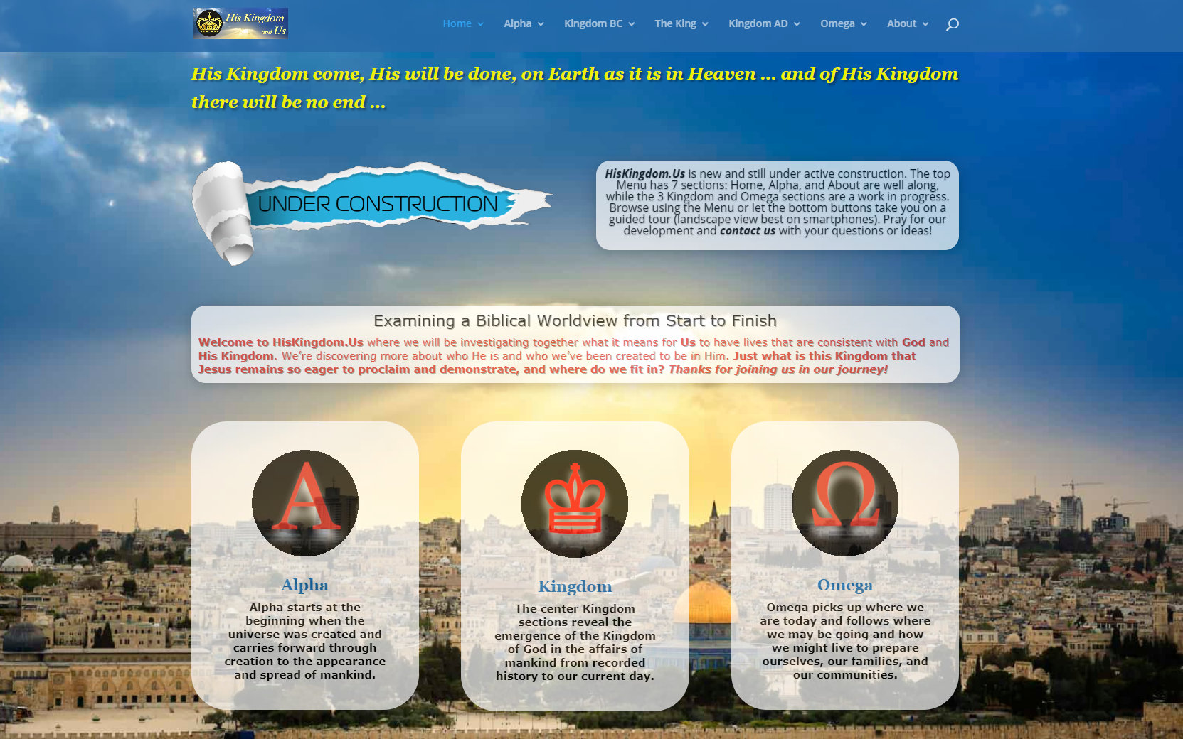
His Kingdom and Us
A Stage 4 project:
New website under construction that highlights God’s love and sovereignty from before creation to beyond the judgment… visitors and comments are welcome.
www.hiskingdom.us
Place your screenshot here

Slide 33
Thanks!
ANY QUESTIONS?
You can find me at
Online: www.wmorehouse.com
Email: wmorehouse@gmail.com
Cell: (585) 314-1144

