Slide 1
FMHF Annual Retreat Serving God Through the Stages of our Lives Dr. Bill Morehouse – September 21, 2019
2

Slide 2
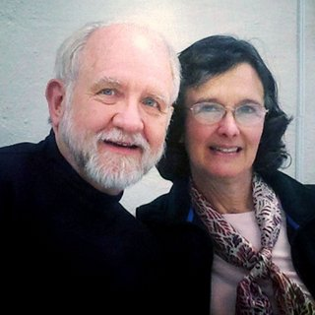
Hello!
This is Bill and Susan again ☺
Welcome back! We’re enjoying getting to know some of you better and are looking forward to our time together with all of you today.

Slide 3
2 Morning topics
Medical practice as a mission
Prayer with patients
Serving the poor
Community outreach
Mentoring students
Preparing for retirement

Slide 4
Medical practice as a mission
A
God’s call to care for the afflicted, either before, during, or after medical training. Is it here or there or all over the place? Can we compartmentalize or should we seek to integrate our faith?

Slide 5
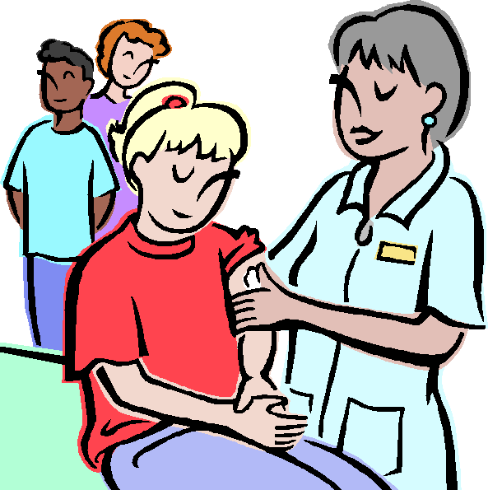
Faith in Word and Deed

Slide 6
Prayer with patients
B
Biopsychosocial medicine with spiritual dimension integrated.
What about faith-related inquiry and prayer? What do patients think? When and how should we get involved?

Slide 7
Ask, seek, knock

Slide 8
Serving the poor
C
Jesus’ attitude toward and relationship with those who “we will always have with us” – the poor. What should be our approach? Who, when, where, and how?

Slide 9
Here, there, or everywhere?
your office?
?
?
?
?

Slide 10
Community outreach
D
What is community? Who are my neighbors? How can we be more comprehensive in reaching out to those around us in love as we seek to provide professional care in the Name of Jesus?

Slide 11
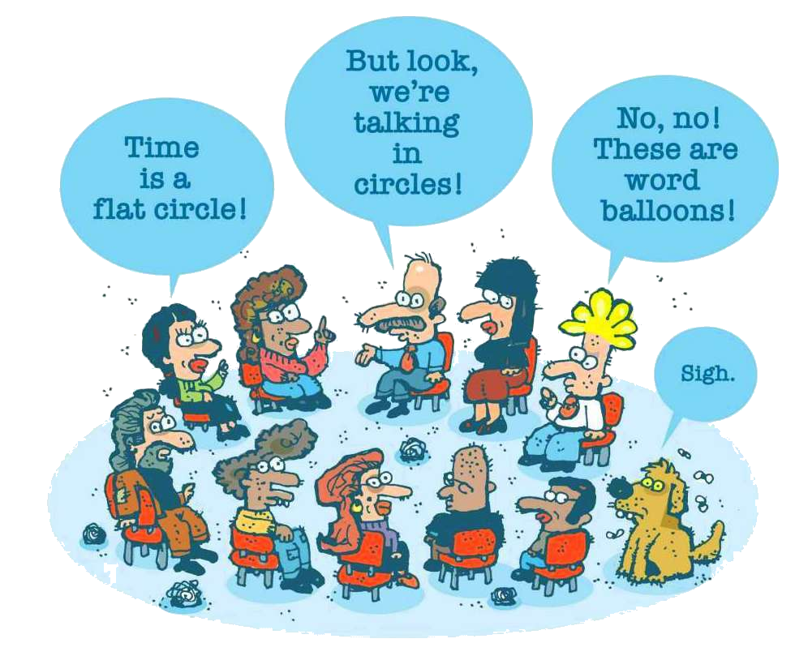
Where do you start?

Slide 12
Mentoring students
E
Students are the next generation. What, where, and how can we pass on our skills, expertise, and experience to them? What could they be looking for from people like us? Is there any reward?

Slide 13
What are your experiences?

Slide 14
Preparing for retirement
F
By the Lord’s grace we may be retiring in the foreseeable future or have already gotten there. How can we prepare for this time of life? The five F’s: Faith, Family, Finances, Fitness, and Fruitfulness.

Slide 15
How are your 5 F’s?

Slide 16
Small Discussion Groups
Community
Outreach
Prayer with Patients
Serving the Poor
Medical Practice
as a Mission
Preparing for retirement
Mentoring
Students

Slide 17
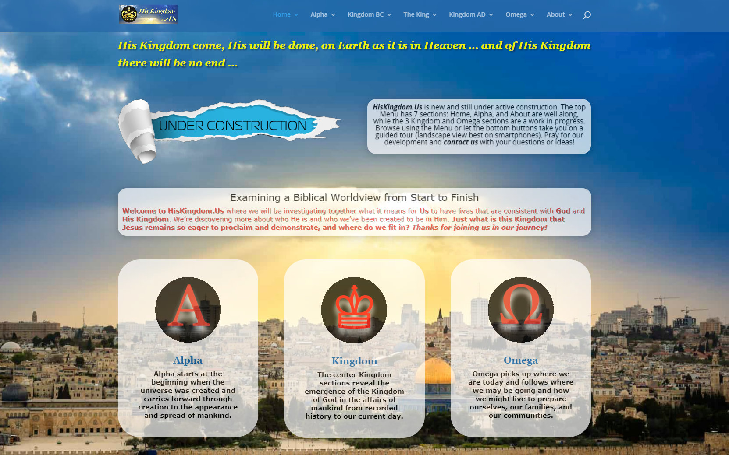
His Kingdom and Us
A community outreach project:
New website under construction that highlights God’s love and sovereignty from before creation to beyond the final judgment… visitors and comments are welcome.
www.hiskingdom.us
Place your screenshot here

Slide 18
Thanks!
ANY QUESTIONS?
You can find me at
Online: www.morehouse.com
Email: wmorehouse@gmail.com
Cell: (585) 314-1144

