Slide 2
Proclaiming Good News Along the Real Life Continuum

Slide 3
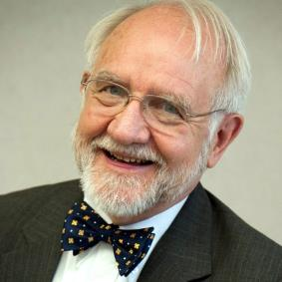
Hello!
I AM BILL MOREHOUSE
I’m here because I love to share good news with people.
www.hisbranches.org
CCHF Conference 3/19

Slide 4
A VERY BIG STORY
Object of Workshop: Helping you share the core message of the Christian faith while you’re living out the Gospel through healthcare among the poor

Slide 5
Bad News?
Our world is in a mess, and so are we:
Sickness, brokenness, division, strife, anger, fear, greed, poverty, famine, hate, corruption, crime, injustice, trafficking, racism, addiction, faithlessness…

Slide 6
Good News?
Our God knows and cares:
He has a plan that involves all of us to bring faith, hope, and love to our broken world, to comfort all who mourn, heal the sick, set captives free, raise up the poor, chastise the unjust, restore what has been devastated, and much more… Love is the answer!

Slide 7
A Prophetic Calling*
…the one who prophesies speaks to people for their upbuilding and encouragement and consolation.
1 Corinthians 14:3
*A seer, a sign, and a standard
Imparting a vision of hope, healing and restoration with guidance for the future

Slide 8
Sharing Good News
4 Spiritual Laws
God’s Love
Man’s Sin
Jesus’ Provision
Receive Christ
Salvation
Campus Crusade
The Big Story
Good Design
Damaged
Restored
Sent
Discipleship InterVarsity
Kingdom Story
John 3:16, etc.
Romans Road
Entire Bible
Lord’s Prayer
Doxology
Creeds
Psalm 23
Kingdom
Personal faith

Slide 9
I am the Vine, you are the branches
We’ve been grafted into the Tree of Life to bear fruit.
Our leaves are for the healing of the nations.

Slide 10
Want to have a big impact? Be a branch, abide in the Vine, bear fruit, and put out lots of leaves!

Slide 11
Gary Gunderson
Spiritual Competencies

Slide 12
Areas of lifestyle involvement
Nutrition – Is diet balanced, healthy, promoting health and well being?
Fitness – Are patient’s regular activities, hygiene, and exercise sufficient to restore and maintain good health?
Sleep/Rest Cycles – Is patient getting enough regular rest, letting go of cares, working too hard, having disturbed sleep?
Life Controlling Behaviors – Are there ongoing problems with unresolved “hurts, hang-ups, and habits”, especially resentments, addictive behaviors, and dysfunctional relationships?
Faith/Spiritual Life– Does patient have a living, functional faith in the only God who cares and is able and willing to comfort, heal, and restore? Are they reconciled to God and walking with Him?
Being a living letter

Slide 13
Sharing from the Word in your heart
John 3:16 – God loves the world and is so committed to rescuing us that He sent His only begotten Son, Jesus, to make His love accessible to us.
The Lord’s Prayer – God is our heavenly Father who provides, forgives, leads, delivers, and rules with Kingdom authority, power, and glory.
Psalm 23 – God is forever faithful to provide, restore, comfort, and lead.
Apostle’s Creed – God the Father, Jesus the Son, and the Holy Spirit all work together in divine harmony with a community of believers to give and work out forgiveness, redemption, resurrection, and eternal life.
Nicene Creed – One God who made heaven and earth, one Lord Jesus who, together with the Holy Spirit, mediates God’s forgiveness and brings salvation, healing, and eternal life to all who believe in Him.
Being a living letter

Slide 14
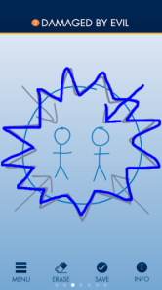
James Choung
The Big Story Gospel Presentation: free app for IOS and Android. 2018
True Story: A Christianity Worth Believing In. 2008
Real Life: A Christianity Worth Living Out. 2012
Place your screenshot here

Slide 15
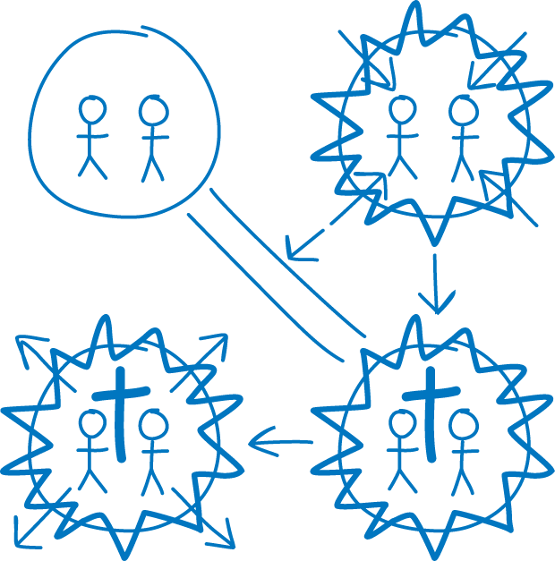
A – The Big Story
James Choung Big True Story

Slide 16
1. Designed for Good
In the Christian worldview, God created a world where everything was designed for good. The picture represents Adam and Eve in the Garden of Eden where everything they needed was provided in a beautiful and bountiful environment. They walked and talked with God and were not troubled by guilt or shame.
James Choung The Big Story

Slide 17
2. Damaged by Evil
But instead of yielding to God’s perfect plan, we and our forebears have pushed against God’s design and bent things to our own purposes. That human tendency to self-will has damaged everything: ourselves, our relationships, and the world around us. In the process our relationship with God has been seriously damaged.
James Choung The Big Story

Slide 18
3. Restored for Better
But God loved the world too much to leave it this way. He came as Jesus. And through His death and resurrection, all of the power and penalty of this junk—in us and around us—dies with Him so that a new life and new world are possible. We can live with God, and He in us. We are forgiven and restored.
James Choung The Big Story

Slide 19
4. Sent Together to Heal
Jesus asked us to be part of what he’s still doing in the world. Quite a while back I became sick and tired of being part of the problem and responded to God’s invitation to be part of His solution. Life has been a wonderfully exciting and challenging experience since then. Would you like to discover and fulfill your part, too?
James Choung The Big Story

Slide 20
B – Generational Priorities
GENERATION
Boomers (1943-1960)
Gen X (1961-1981)
Millennials (1982-2002)
iGen (2003-2022)
Wrappers (2023-2043)
SPIRITUAL QUESTION
What is True?
What is Real?
What is Good?
What is Beautiful?
What is it All About?
“Men resemble the times more than they resemble their fathers.” American culture has been shown to go in a cycle of value priorities that shifts every 20 years and then repeats itself after every 4 generations.
James Choung Real Life Continuum

Slide 21
5-Generations in a Century
1943-1960 1961-1981 1982-2002 2003-2022 2023-2043
1943 Boomers Gen X Millennials iGen Wrappers 2043
Truth Real Good Beautiful All About
James Choung Real Life Continuum

Slide 22
Living Letters
Finally, brothers, whatever is true, whatever is honorable, whatever is just, whatever is pure, whatever is lovely, whatever is commendable, if there is any excellence, if there is anything worthy of praise, think about these things.
Philippians 4:8

Slide 23
How to do it
Do not rebuke an older man but encourage him as you would a father, younger men as brothers, older women as mothers, younger women as sisters, in all purity.
1 Timothy 5:1-2

Slide 24
Goal good character
Sow a thought and you reap an action; sow an act and you reap a habit; sow a habit and you reap a character; sow a character and you reap a destiny.
Ralph Waldo Emerson

Slide 25
C – Discipleship Stages
Think Revival!
STAGE
Skeptic
Seeker
Follower
Leader
World changer
DISCIPLESHIP TASK
Trust building
Challenge decision
Recognize God’s Voice
Empower to serve
Envision future
Note that evangelism is included in Choung’s discipleship scheme. This involves finding out where each person is and sharing pertinent “Good News” with them where they are in their spiritual development.
James Choung Real Life Continuum

Slide 26
Discipleship Spectrum
Don’t forget that you and other staff and providers need discipleship, too!
Alienated Interested Committed Motivated Missional
Youth Skeptic Seeker Follower Leader Changer Mature
Trust Challenge Recognize Empower Envision
Steps in Christian Growth:
Initial conviction and conversion
Commitment to Christ, baptism
Prayer for fullness of the Holy Spirit
Discipleship in “milk of the word” then “meat”
Full repentance, healing, restoration of past hurts, hang-ups, and habits
Establishment in service/leadership
Sending forth into broader community witness
James Choung Real Life Continuum

Slide 27
The Kingdom Story
God’s in charge of everything – He’s the King!
He’s the Author of love and healing
He loves the world and all the people He created
He lives in eternity, so he is always with us
He knows all about you and still loves you
We can’t handle life alone without His help
Nothing is too big or too small to ask for His help
God hears, answers prayer, and brings answers
He has a very good plan for your future
Open your heart wide, receive His love
We can ask anytime, even now together
The best is yet to come!
Living in the Kingdom

Slide 28
Personal Development
Confidence in the Father’s love and forgiveness
Secure commitment to Christ and His Word
Empowerment with the Holy Spirit
Ongoing awareness of God’s presence
Organized daily devotions, prayer, meditation
Regular Scripture study, contemplation
Sacraments, fellowship, worship, participation
Commitment and service to family/others
Growing in character and fruit of the Spirit
Embracing calling and serving with love
Sharing with and discipling others
Abiding in the Vine

Slide 29
James Choung Real Life Continuum
Where are you?

Slide 30
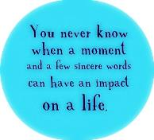
Sharing Good News Review
A Lifestyle
Sharing becomes part of a provider’s lifestyle, both inside and outside the office, stemming from their heart.
Interwoven
Sharing is a seamless part of the clinical and personal encounter with each individual, tailored to their circumstances.
Natural
Sharing is the fruit of study, meditation, prayer, and gaining understanding of the human condition and God’s love for us.
Technique
It is not a formula or technique that can be pulled out and applied like resetting a dislocated joint or applying a bandage.
Add On
It is not an optional add on to an unusual or particularly difficult visit which is done infrequently when time will permit.
Artificial
It is not an artificial “spiritual” intrusion into an otherwise competent but primarily secular clinical encounter.
Living out the Gospel

Slide 31
Selected Bibliography
Henry T. Blackaby
Experiencing God: Knowing and Doing the Will of God. Nashville, TN: B&H Books; Revised edition, 2008.
James Choung
True Story: A Christianity Worth Believing In. Downers Grove, IL: InterVarsity Press, 2008.
Real Life: A Christianity Worth Living Out. Downers Grove, IL: InterVarsity Press, 2012.
C. S. Lewis
Mere Christianity. First published in 1952. San Francisco, CA: HarperOne; Revised & Enlarged edition, 2015.
George E. Ladd
The Gospel of the Kingdom. Grand Rapids, MI: Eerdmans, 1959. An outstanding resource, reprinted in paperback by Martino Publishing in 2011.
Sorge, Bob
Reset: 20 Ways to a Consistent Prayer Life. Grandview, MO: Oasis House, 2018.
Wright, N. T.
How God Became King: The Forgotten Story of the Gospels. New York: HarperCollins, 2012.
Simply Christian: Why Christianity Makes Sense. New York: HarperOne, 2010.

Slide 32
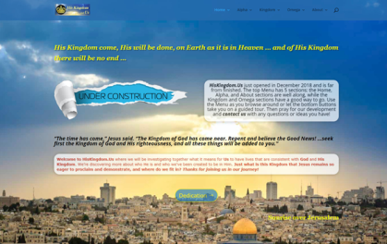
HIS KINGDOM and US
What the Lord has me working on now, among other things...
Place your screenshot here
HisKingdom.Us

Slide 33
Thanks!
ANY QUESTIONS?
You can find me at
www.hiskingdom.us
wmorehouse@hisbranches.org

